Slide 1

Behavioral Cloning using Deep Learning
Notes:
Intro, greeting, topic – 1.5 min

Slide 2
AGENDA
Conventional Coding vs Machine Learning
AI vs Machine Learning vs Deep Learning
Deep Learning Applications
Deep Learning Building Blocks - Neural Networks
Human Brain and Neural Networks
How Deep?
How about Learning?
Autonomous Driving using Behavioral Cloning
TensorFlow and TensorBoard
TensorBoard in Action
Transfer Learning
Notes:
20 seconds

Slide 3
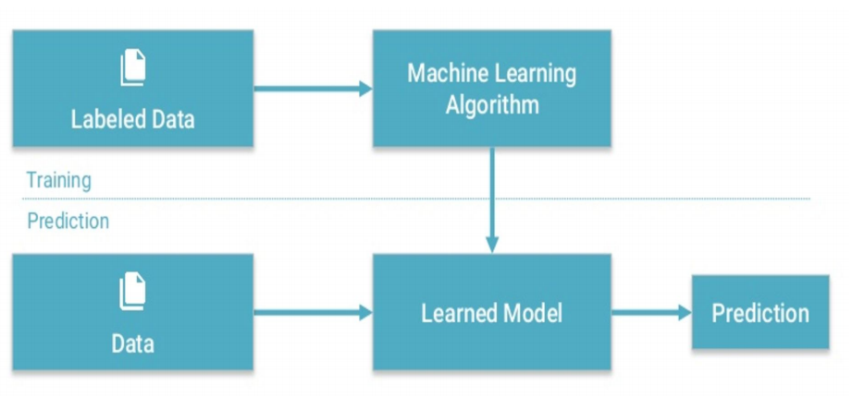
CONVENTIONAL CODING vs MACHINE LEARNING
Notes:
30 seconds

Slide 4
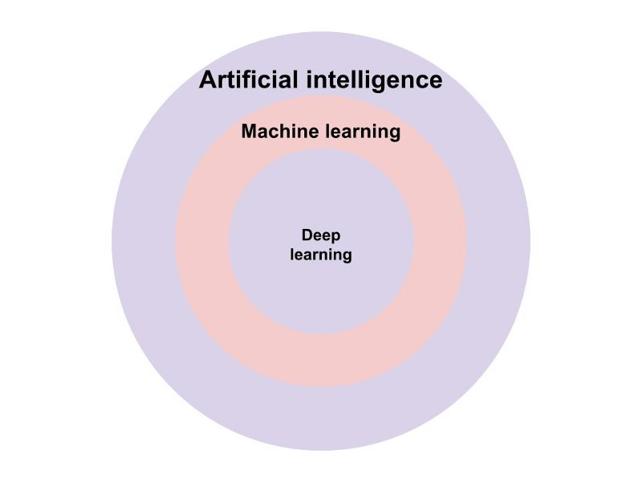
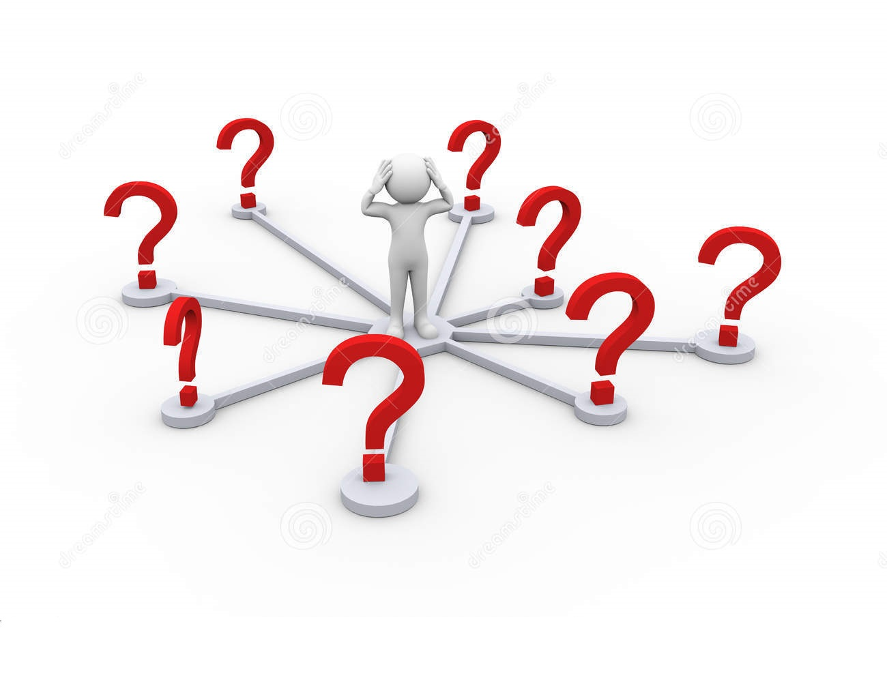
AI vs MACHINE LEARNING vs DEEP LEARNING
Notes:
1 min

Slide 5
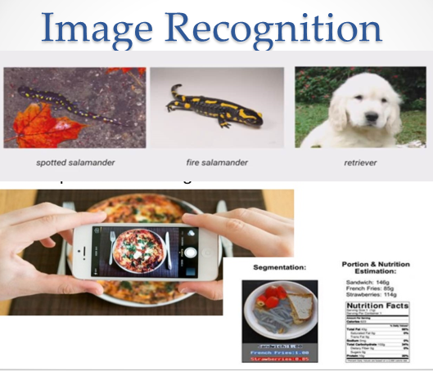
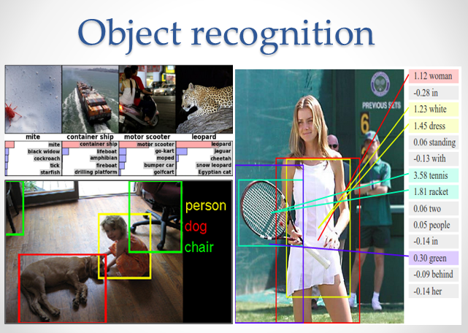
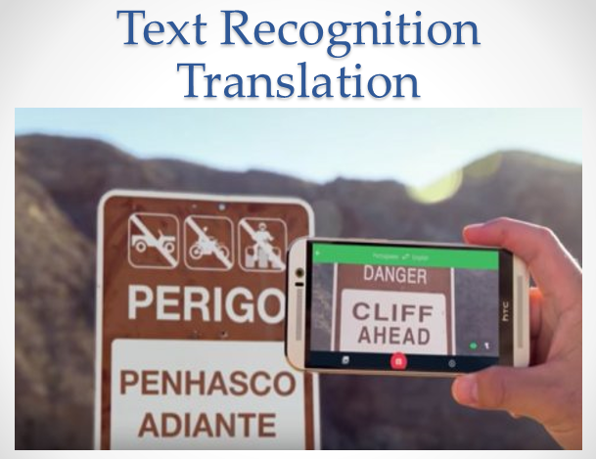
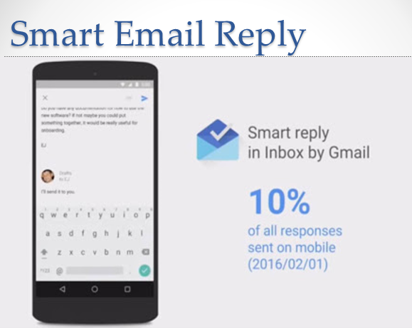
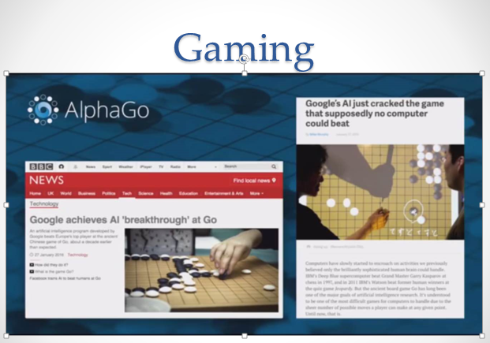
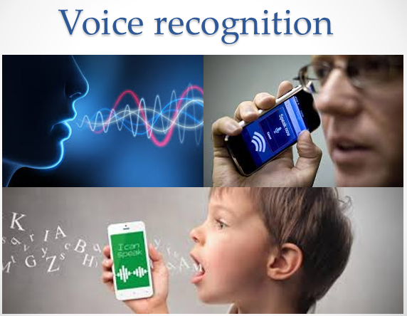
DEEP LEARNING APPLICATIONS
Notes:
20 seconds

Slide 6
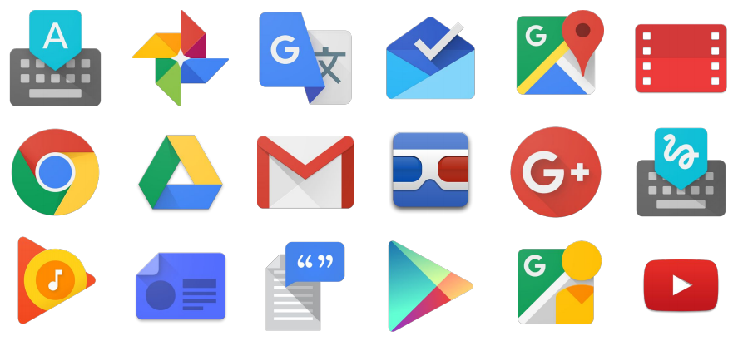
GOOGLE PRODUCTS USING DEEP LEARNING
Notes:
10 seconds

Slide 7
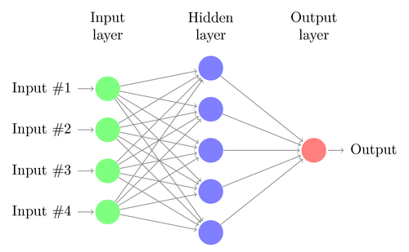
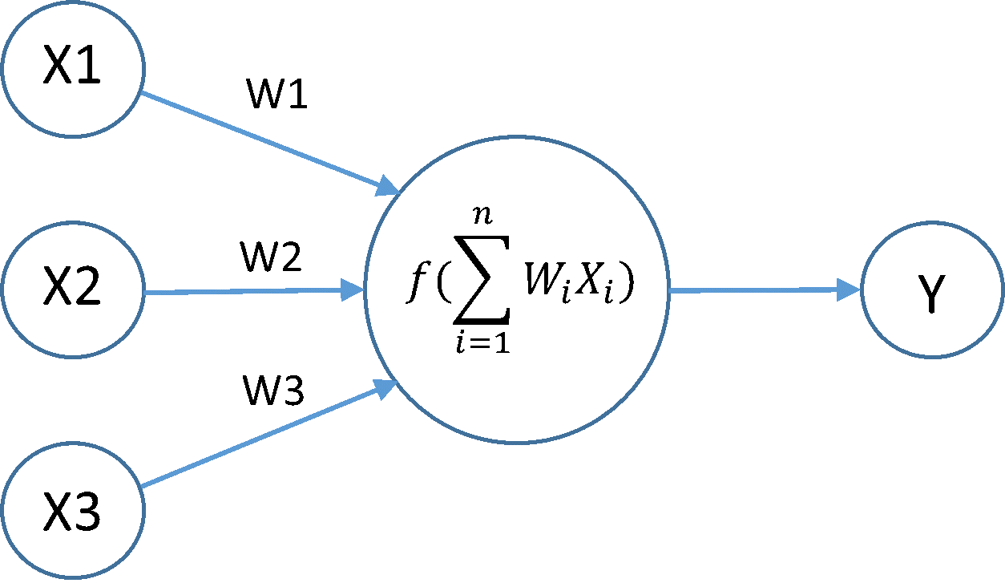
DEEP LEARNING BUILDING BLOCKS – NEURAL NETWORKS
VISUAL REPRESENTATION
MATHEMATICAL REPRESENTATION
Notes:
50 seconds

Slide 8
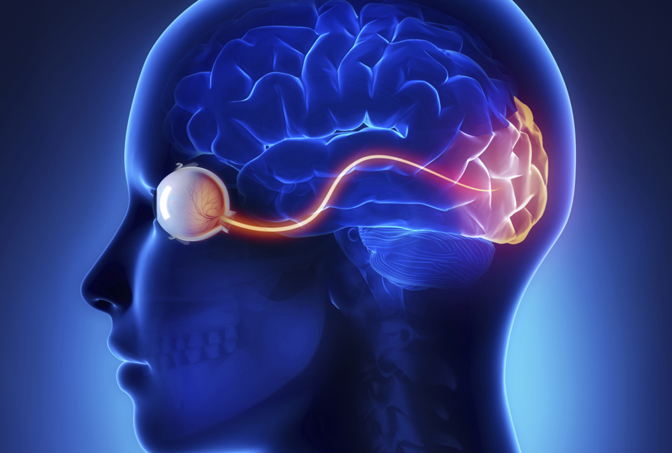
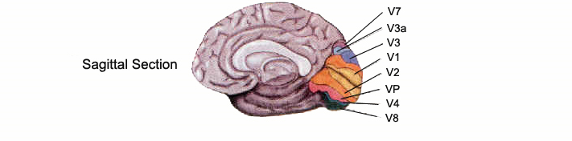
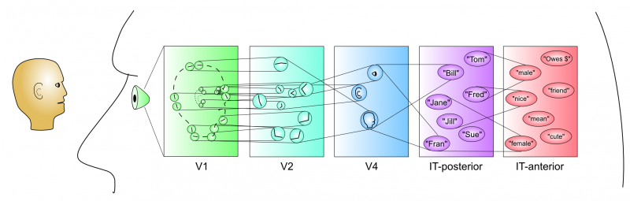
HUMAN BRAIN AND NEURAL NETWORKS
Notes:
30 seconds

Slide 9

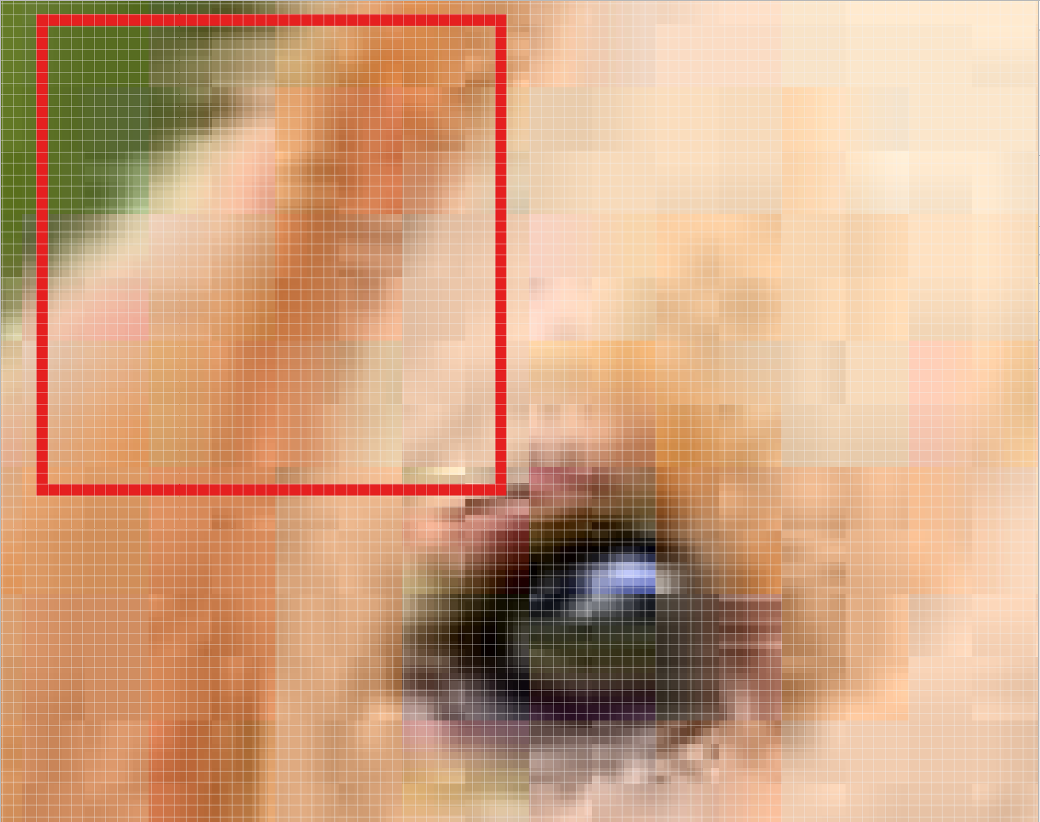
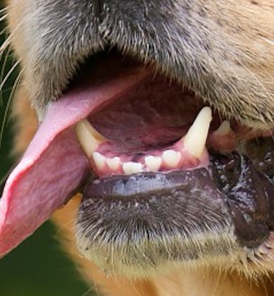
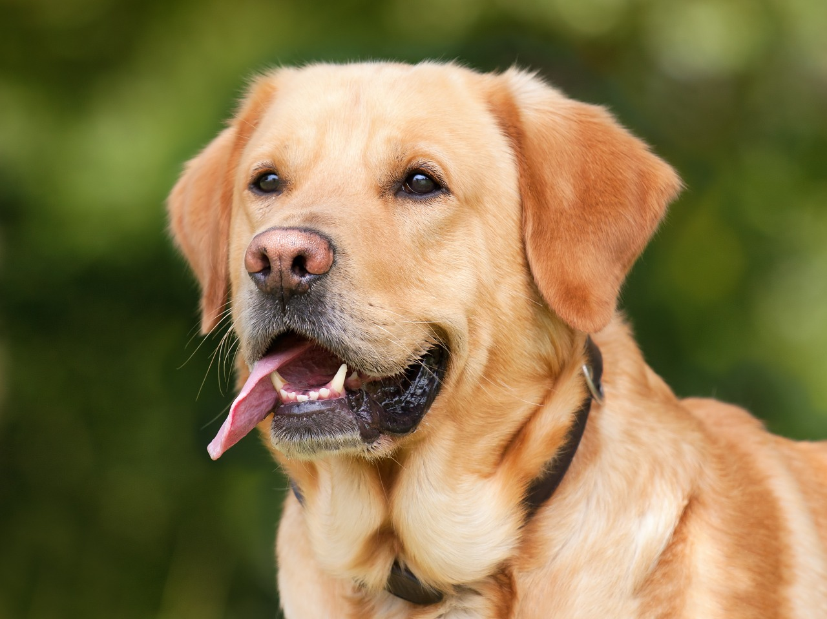
HOW DEEP?
Notes:
30 seconds

Slide 10

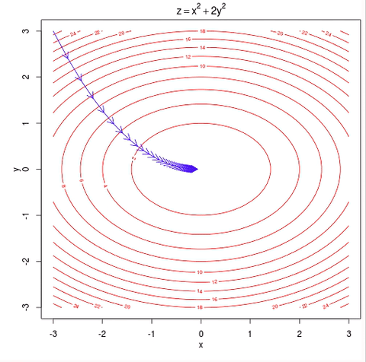
HOW ABOUT LEARNING?
Notes:
50 seconds

Slide 11
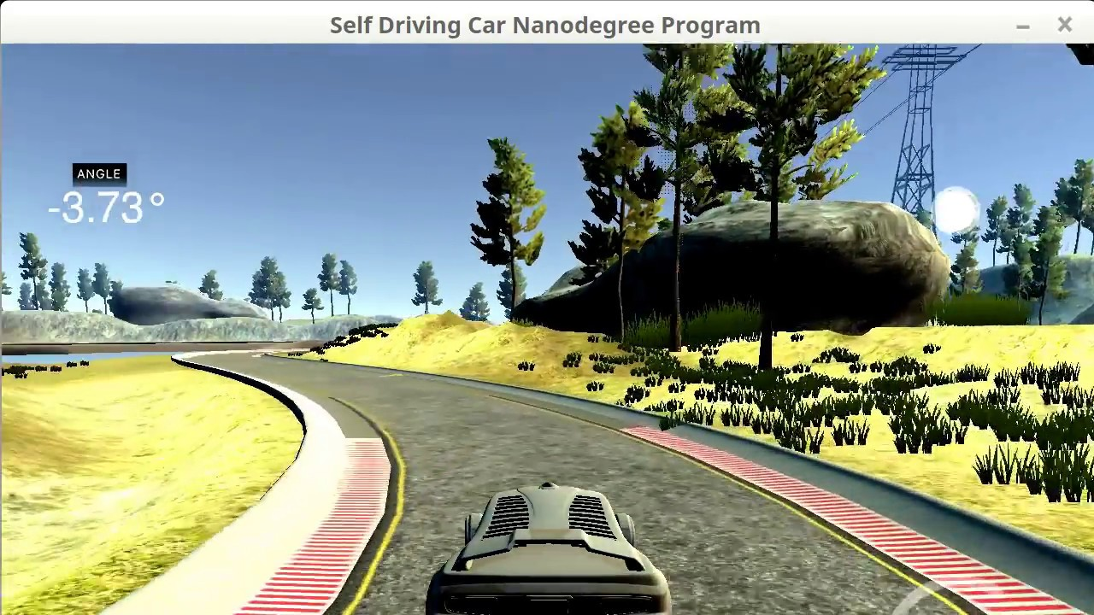
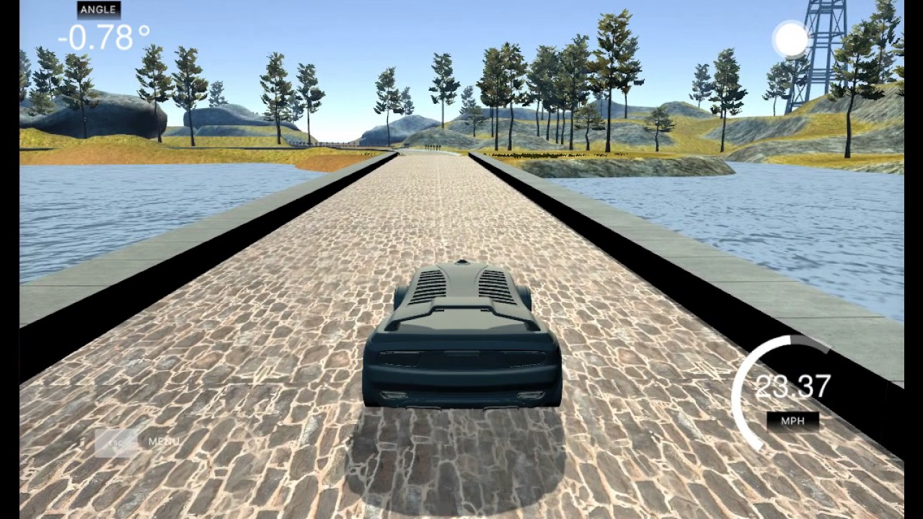
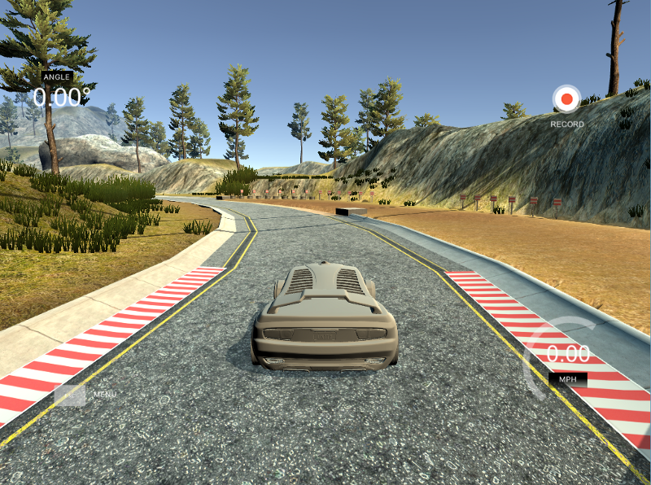
AUTONOMOUS DRIVING USING BEHAVIORAL CLONING
Simulator – Built in Unity by team at Udacity for Self driving car nanodegree program
Network Architecture – ‘End to end learning for self-driving cars’ by team at NVIDIA
Model built using ‘Keras’ framework in Python
Notes:
4 minutes

Slide 12
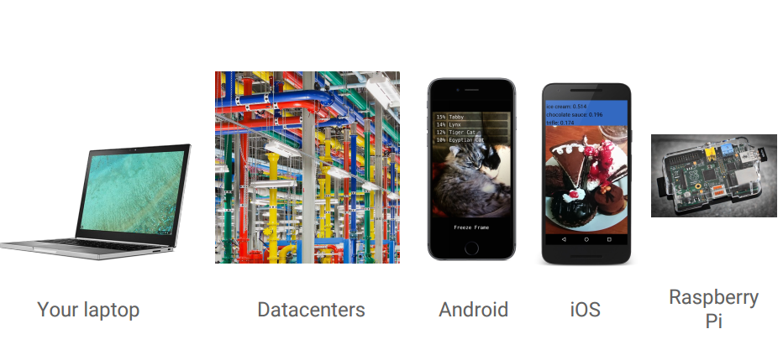
TENSORFLOW and TENSORBOARD
TensorFlow™ is an open source software library for numerical computation and machine learning.
Used for Deep Learning in research and production
Developed by Google Brain Team
Most popular machine learning library.
Over 32,000 downloads
TensorBoard is a flash light for Deep learning black boxes
Used to visualize network graphs, learning curves, activations and a lot more
Notes:
1 min

Slide 13
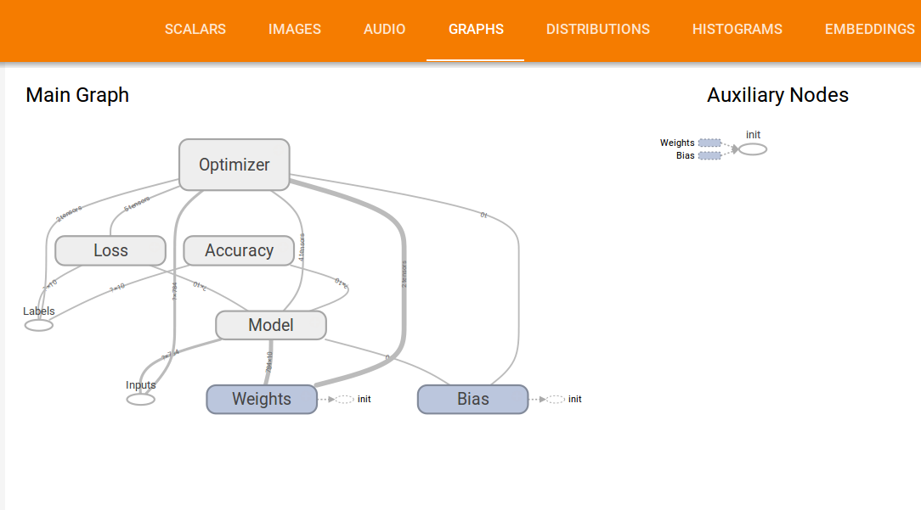
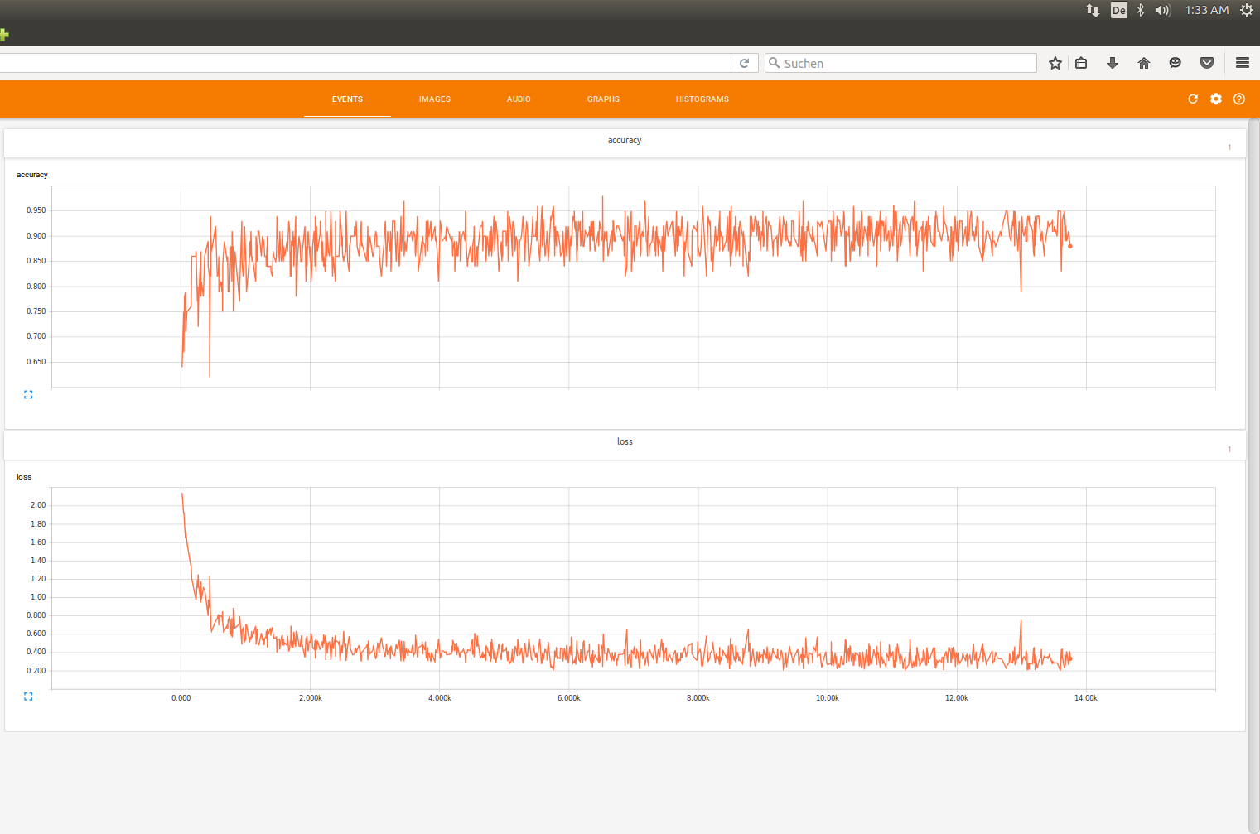
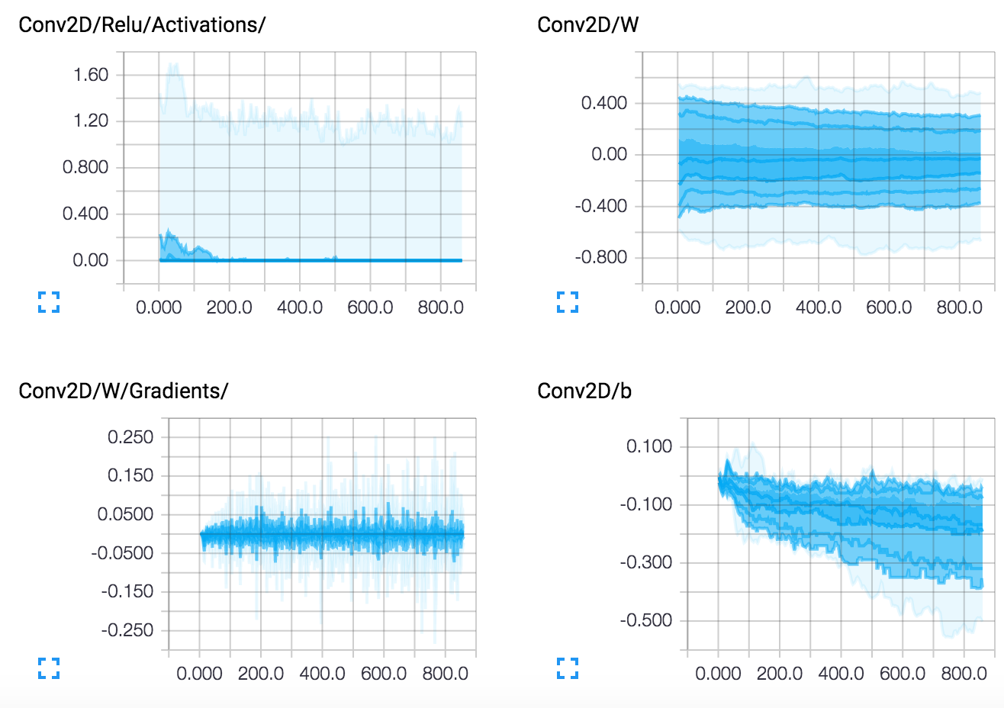
TENSORBOARD IN ACTION
Notes:
1 min

Slide 14
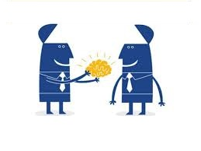
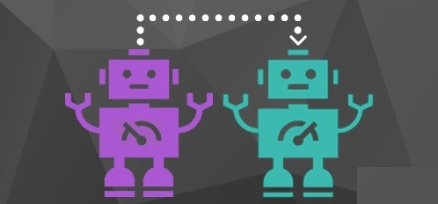
TRANSFER LEARNING
Hey, wouldn’t it be cool if I could transfer all my knowledge
and experience to you, and vice versa?
Haha losers! We are already doing that!
Notes:
30 seconds + 1.5 min

Slide 15
QUESTIONS?
We are happy to help you!
Please mail us your queries to Saurabh Sohoni or Karthikeyan Palanisamy and we will get back to you at the earliest!
Notes:
3 min

Slide 16
THANK YOU

